Slide 1

Terminal Based File Explorer
A mini-project on Unix System Programming
Moksh Jayanth 1BM19IS094
Mohan D 1BM19IS092
N Prabhu 1BM19IS096
Faculty in-charge : Anitha H M
July 29, 2021
MINI PROJECT | FILE EXPLORER

Slide 2


Objectives
The objectives of the project are :
to design a terminal-based File Explorer which can work on Linux and Unix-based operating systems.
to design the File Explorer with two different modes i.e to use cursor-based user interface along with the command-line interface.
to apply Unix system programming concepts using c++.

Slide 3

Introduction
The File explorer is an application that will run on a terminal with simple cursor-based UI (which can be controlled by keyboard)
This application will work in two modes :
Normal Mode: used to explore the current directory and navigate the filesystem. (Keyboard can be used to navigate.)
Command Mode: used to enter and execute shell commands.

Slide 4



Two Basic Modes
Normal Mode
The File explorer shows each file in the directory (one entry per each line). The following are the attributes visible for each file
File Name
File size
Ownership (User & Group) & Permissions
Last modified
The File explorer also handles scrolling in case the directory has a lot of files.
The file explorer also shows the entries “.” & “..” for current and parent directory respectively.
User is able to navigate up & down the file list using corresponding arrow keys.
When the Enter Key is pressed, the file will be opened in corresponding default application.

Slide 5
2. Command Mode
The application will enter the command mode whenever the : (colon) key is pressed.
The command Mode will support the following commands, and the syntax are given below:
Copy - copy <source_file(s)> <destination_directory>
Move - move <source_file(s)> <destination_directory>
Rename - rename <old_filename> <new_filename>
Create File - create_file <file_name> <destination_path>
Create Directory - create_dir <dir_name> <destination_path>
Delete File - delete_file <file_path>
Delete Directory - delete_dir <dir_path>
Goto - goto <destination>
Search - search <file_name> or search <directory_name>

Slide 6
APIs used
General file APIs
open()
read()
write()
close()
stat
Directory file APIs
opendir()
readdir()
chdir()
closedir()
mkdir()
rmdir()
Symbolic link APIs
lstat()
link()
unlink()

Slide 7
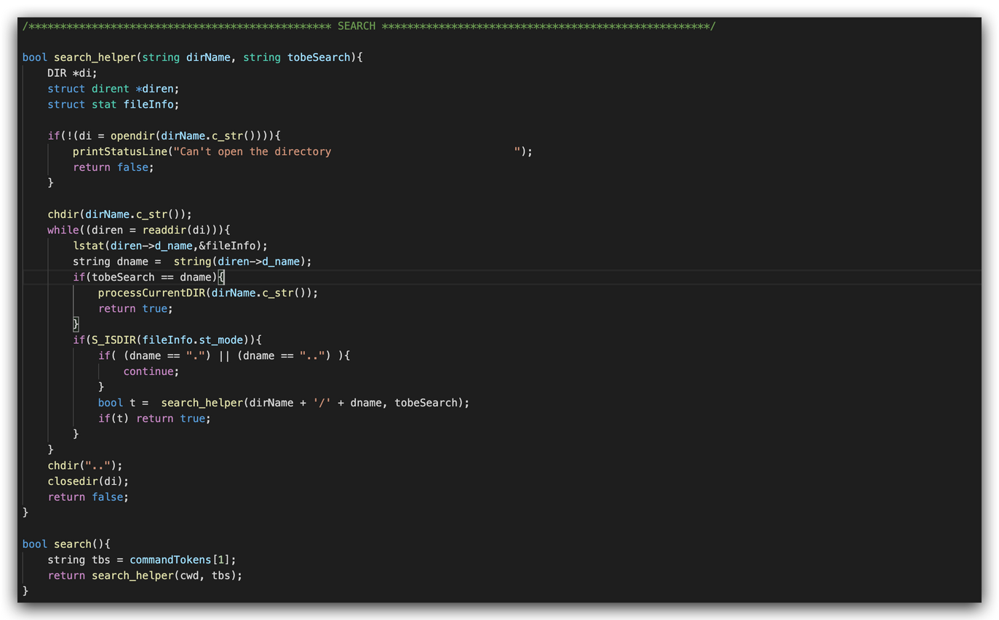
Implementation
SOME OF THE IMPORTANT CODE SNIPPETS :
Search Files/Directories

Slide 8

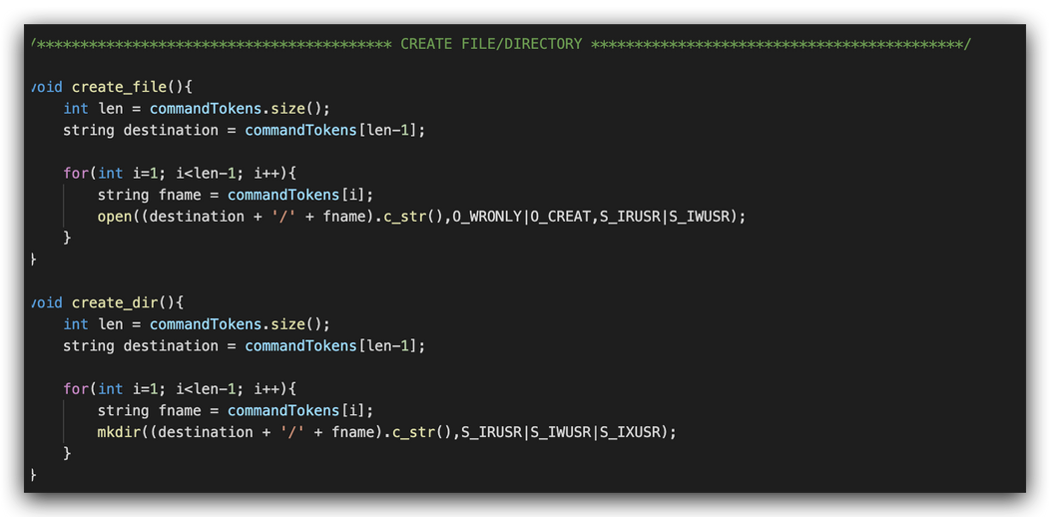
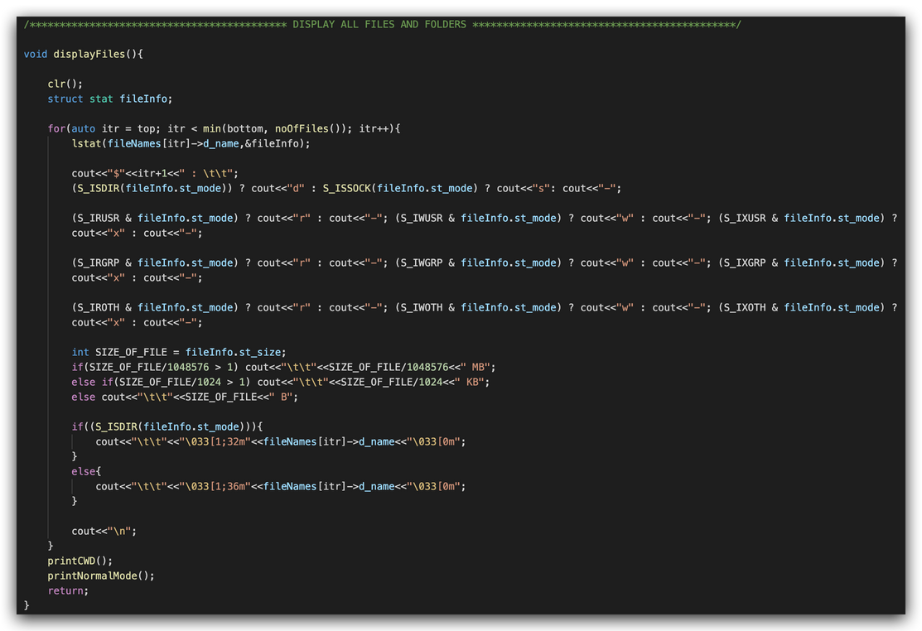
Create File/Directory
Display files and it's Permissions

Slide 9
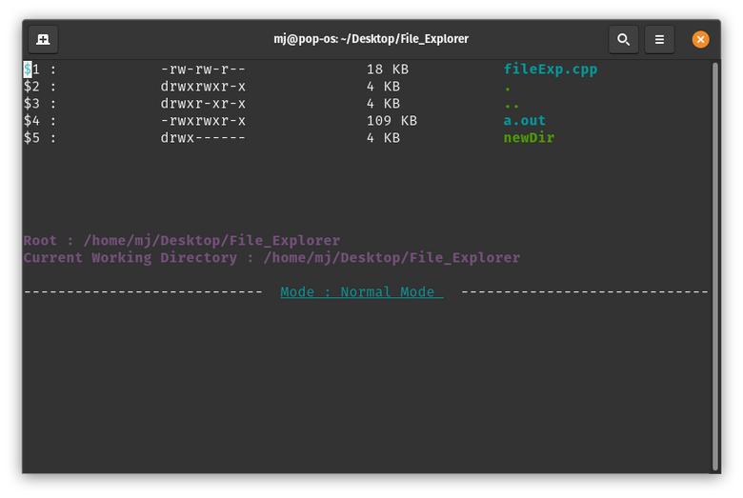
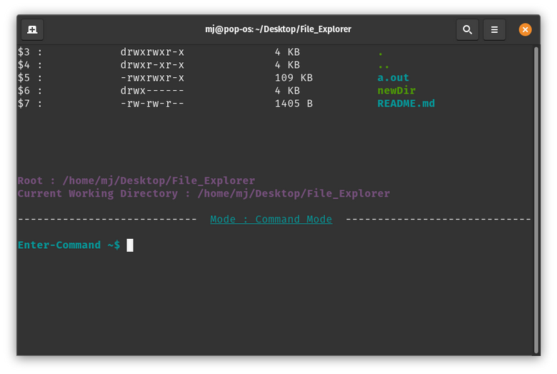
Snapshots Of The Project Design
Normal Mode
Command Mode

Slide 10

Thank You
"Experience is simply the name we give our mistakes"
— Oscar Wilde

